Slide 1


NGSS Connections to the Skeletal Muscle Module

Slide 2
NGSS Connections to Skeletal Muscles Module
High School
Main Connection
HS-LS1-2: Develop and use a model to illustrate the hierarchical organization of interacting systems that provide specific functions within multicellular organisms.

Slide 3
NGSS Connections to Skeletal Muscles Module
High School
Supporting Connections – Life Science
HS-LS1-1: Construct an explanation based on evidence for how the structure of DNA determines the structure of proteins which carry out the essential functions of life through systems of specialized cells.
HS-LS1-3: Plan and conduct an investigation to provide evidence that feedback mechanisms maintain homeostasis.
HS-LS3-1: Ask questions to clarify relationships about the role of DNA and chromosomes in coding the instructions for characteristic traits passed from parents to offspring.
HS-LS3-2: Make and defend a claim based on evidence that inheritable genetic variations may result from: (1) new genetic combinations through meiosis, (2) viable errors occurring during replication, and/or (3) mutations caused by environmental factors.

Slide 4
NGSS Connections to Skeletal Muscles Module
High School
Supporting Connections – Physcial Science
HS-PS3-2: Develop and use models to illustrate that energy at the macroscopic scale can be accounted for as a combination of energy associated with the motion of particles (object) and energy associated with the relative positions of particles (objects).
HS-PS3-3: Design, build, and refine a device that works within given constraints to convert one form of energy into another form of energy.

Slide 5
NGSS Connections to Skeletal Muscles Module
Middle School
Main Connection
MS-LS1-2: Develop and use a model to describe the function of a cell as a whole and ways parts of cells contribute to the function.
MS-LS1-3: Use argument supported by evidence for how the body is a system of interacting subsystems composed of groups of cells.
Supporting Connections
MS-LS1-1: Conduct an investigation to provide evidence that living things are made of cells; either one cell or many different numbers and types of cells.
MS-LS1-8: Gather and synthesize information that sensory receptors respond to stimuli by sending messages to the brain for immediate behavior or storage as memories.

Slide 6
Skeletal Muscle
Story Line
You and your classmates have just learned that a peer in your class has recently been diagnosed with muscular dystrophy. The student and his family are trying to better understand the disease. Your teacher thinks this is a great idea for your class to research as long as the student and his parents are willing to accept help from the class. She has just learned that they would appreciate the assistance.
To be able to manage this adventure, the teacher will divide the class into groups of four or five students. Each group will complete the first activity in the module.

Slide 7
Task 1: Making a Hypothesis
Your muscles generate electrical activity from the movement of ions. Make hypotheses to answer each of the following questions.
How much electrical activity would you expect to measure when your muscles are at rest? (e.g., none, very little, some, a great amount?)
How will the electrical activity of your muscles change when you move from a resting state to contracting as you lift a weight?
What would you expect to see in the electrical activity output when a muscle is fatigued?
Will electrical activity in similar states vary across students? What do you expect to observe?

Slide 8
Task 1 Data Analysis
Questions to guide students in data analysis
Looking over the data and thinking about what you have learned about muscles, how can you explain the results for lifting weights of different amounts?
What causes fatigue and how does lifting weight relate to fatigue?
Looking at the data in Table 1, what is the relationship between the time to fatigue and the amount of weight?
What suggestions would you make to help recover from fatigued skeletal muscles?
What might you suggest if a heavy object needed to be carried by hand, such as the books on a rope in these experiments?
If an experiment was conducted with the dominant and non-dominant arms, were there differences in the time to fatigue for the same amount of weight lifted? Explain the results.

Slide 9
Tasks 2 and 3
Task 2: Research and create a physical model of a sarcomere (muscle contractile unit) with accompanying written explanations to describe the cellular anatomy and to illustrate differences between healthy and diseased states.
Task 3: Conduct a literature search on the disease process of muscular dystrophy and its treatments. Then construct a written summary with drawn diagrams or 3-D models to illustrate differences in the disease state of sarcomeres in persons with muscular dystrophy.

Slide 10
Task 2: Anatomy of the Sarcomere
Research how the smallest contractile unit from skeletal muscle, called a sarcomere, works in a healthy state.
Look for the basic anatomy of skeletal muscle cells
Learn how muscle contraction occurs
Draw two diagrams of three skeletal muscle units
Relaxed state
Contracted state

Slide 11
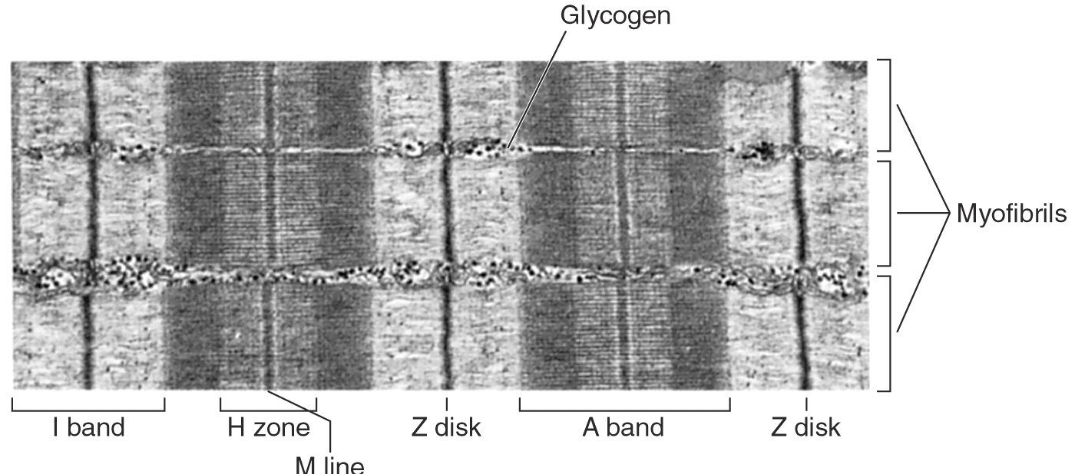
Task 2: Relaxed Skeletal Muscle
Label the actin, myosin, thin filament, thick filament, Z-disk, where the myosin heads are located

Slide 12
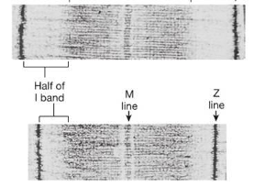
Contracted State of Skeletal Muscle
Note which bands change in dimension during contraction and which ones do not

Slide 13
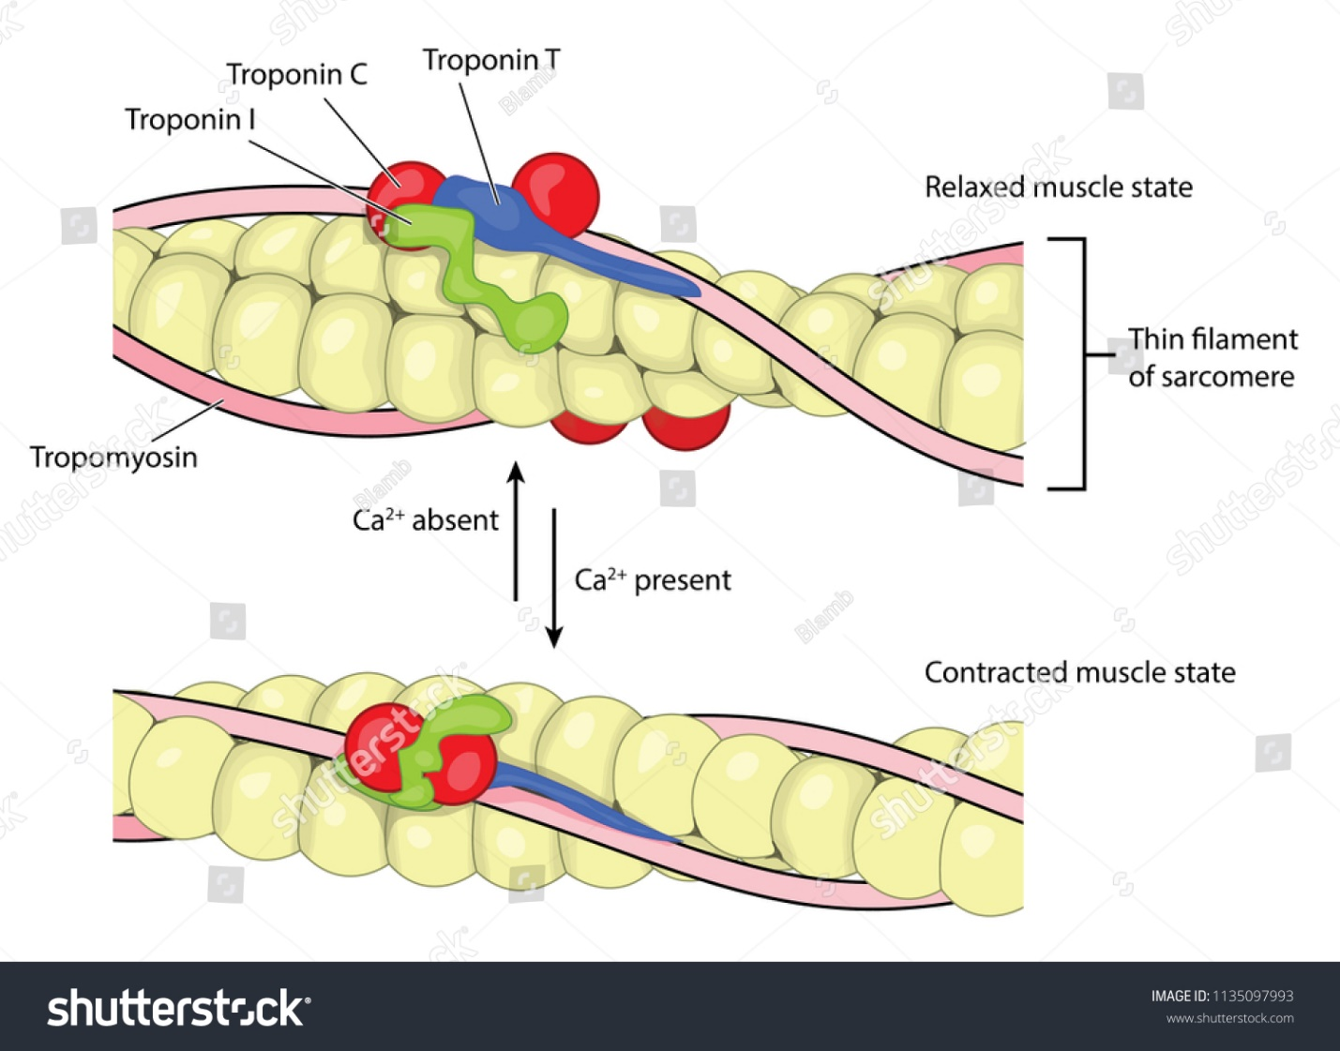
Task 2: Drawing 3- Thin Filament
Draw a third drawing to show an enlarged view of the thin filament with the two actin strands twisted along with the troponins (troponin C, troponin I, and troponin T) and the protein tropomyosin.
Label where an active site might be located for a myosin head to bind.
Label the locations of the troponins around an active binding site and illustrate interaction with tropomyosin structure.

Slide 15
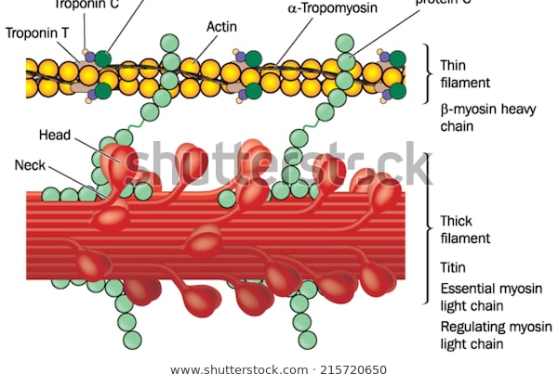
Comparison of the thin and thick filaments

Slide 16
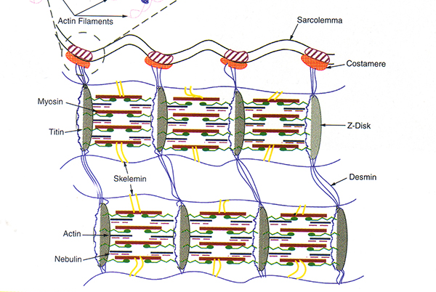
More complex illustration of contractile element
Use the keyword search terms muscle, titin, sarcomere together to locate information on titan.

Slide 17
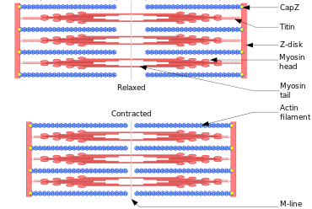
Contractile Element illustrating Titin
Students can add titan and dystrophin around the figure of the sarcomeres

Slide 18
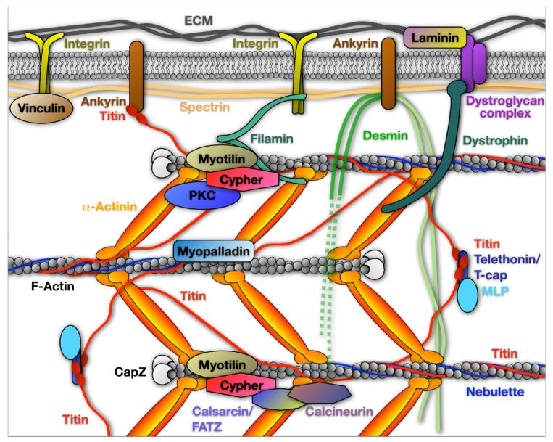
Task 3: Muscle Structure in Muscular Dystrophy
Knowing the location of dystrophin in relation to the contractile units, students can think about answers to the following questions.
What would happen if dystrophin was removed from the cell?
What would happen if there was a mutation in the protein sequence?
Explain what would happen if there was not any dystrophin, or what would happen if there is a mutated form of dystrophin?
How would this affect the forces from the contractile elements to the plasma membrane?

Slide 19
Physiology of a Muscle Cell
Go through a stepwise sequence process to explain how skeletal muscle contracts as the muscle membrane (sarcolemma) is depolarized due to acetylcholine release from the motor nerve terminal.
Acetylcholine (ACh) causes depolarization of the plasma membrane of the muscle
An action potential travels along the plasma membrane and down T- tubules.
The sarcoplasmic reticulum (SR) inside the muscle cell releases Ca²⁺ to then raise Ca²⁺ within the cytoplasm inside the muscle.
Ca²⁺ ions bind with troponin causes tropomyosin to move and an active site is exposed on actin for the myosin head
Myosin binds to actin
Contraction starts and the sarcomeres shorten
The myosin heads releases the ADP, and Pi and comes of the active site while the head rotates back and returns to be ready to bind to an active site again
Ca²⁺ levels return to a lower level in the cytoplasm

Slide 20
Tasks 2 and 3
Task 2: Research and create a physical model of a sarcomere (muscle contractile unit) with accompanying written explanations to describe the cellular anatomy and to illustrate differences between healthy and diseased states.
Task 3: Conduct a literature search on the disease process of muscular dystrophy and its treatments. Then construct a written summary with drawn diagrams or 3-D models to illustrate differences in the disease state of sarcomeres in persons with muscular dystrophy.

Slide 21
Task 3: Making Sense of Muscular Dystrophy
Student Instructions
Your group is tasked with learning about the disease process of muscular dystrophy and treatments. Conducting a literature search using an online search engine such as Google Scholar will provide quick access to information. What follows are some key words to get you started.
  muscular dystrophy define
  types of muscular dystrophy
  what is muscular dystrophy

Slide 22
Task 3: Making Sense of Muscular Dystrophy
Next, search on internet how muscular dystrophy develops. Some key words to use are:
  causes of muscular dystrophy
  genetics muscular dystrophy
List the various causes known for developing the various types of muscular dystrophy.
Table 2. Muscular Dystrophy Research Table
Types | Causes

Slide 23
Task 3: Making Sense of Muscular Dystrophy
Next search the internet on treatments and therapy for muscular dystrophy. Some key words to use are:
  therapy for muscular dystrophy
  treatment of muscular dystrophy
  Table 2. Muscular Dystrophy Research Table
Types | Causes | Therapy | Treatment

Slide 24
Task 4: Public Awareness Information Display or Poster
Here are some ideas:
Create a poster or a Piktochart to illustrate sarcomeres and how they work, what happens in the disease state of muscular dystrophy, and possible treatments.

Slide 25
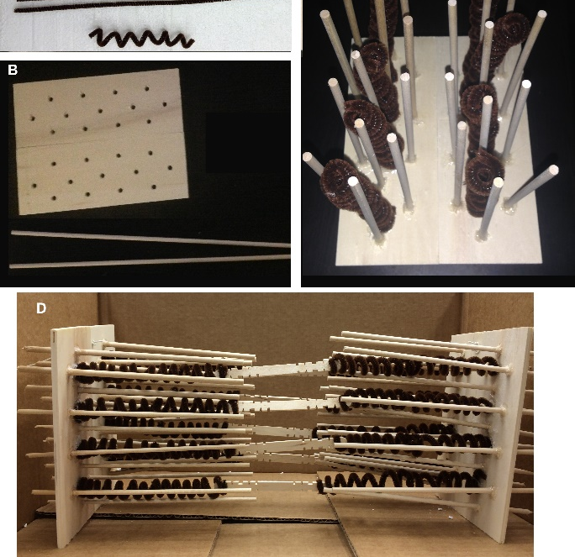
Task 4: Public Awareness Information Display
Plan a 3-D display to illustrate healthy working muscle cells in comparison to muscle cells in disease state of muscular dystrophy.
Other hands-on activities could be planned around a tabling event, such as EMG activities models, and other pamphlets distributed to the public.

Slide 26
Task 4: Awareness Information Display or Poster
Display Criteria
Demonstrate the anatomy of skeletal muscle and how muscle contraction occurs
Define muscular dystrophy and how the disease occurs
Differentiate the types of muscular dystrophy and demarcate the forms.
Show where the dystrophin complex is located and how this can effect muscle strength and weakness
Present current treatments and therapies for muscular dystrophy.

